Slide 1
MRI of anal Fistula
Christine Hoeffel
CHU Reims

Slide 2
Objectives
Indications of MRI
Technique
Anatomy
Classification

Slide 3
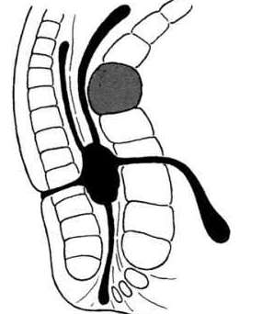
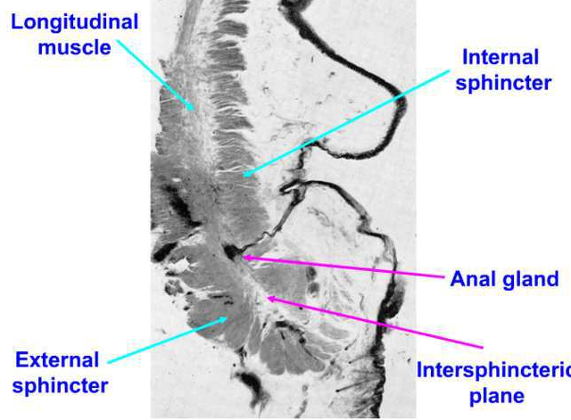
Fistula in ano
Track communicating with the rectum or the anal canal via an internal opening and generally with an external opening
Infection of an intersphincteric gland-followed by drainage of the abscess in every directions

Slide 4
WHY and WHEN MRI ?
Endoscopic Ultrasonography
  Particularly for intersphincteric fistulas
  Less accurate in case of sepsis or complex fistulas
MRI
  First-step examination in case of recurrent fistula
  If presence of a complex fistula at US or clinical examination
  Before anti-TNF treatment
Williams Dis Colon Rectum 2007

Slide 5
MRI Technique
Sequence Selection
Planes
Slices orientation

Slide 6
MRI Technique
1.5 Tesla or 3 T
Phased-array coil, without any preparation nor endorectal probe.

Slide 7
Sequences
  Anatomical sequences
    Sag T2
    Axial T2
  Imaging of edema
    STIR
    Fat-suppressed T2
  Imaging of enhancement
    Gadolinium

Slide 8
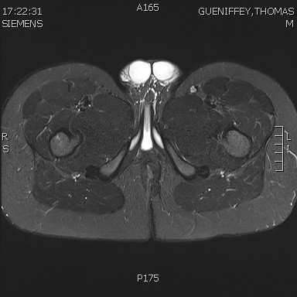
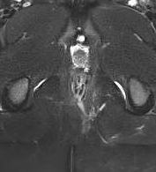
How to choose sequences ?
After tt STIR
T2 Fsup/STIR
    Simple
    No injection
    High signal intensity of the inflammatory tract
    Fibrous areas low signal intensity
    Less sensitive for very thin tracts
    Difficult to differentiate inflammation from fluid
Before tt STIR
HALLIGAN Radiology 2006

Slide 9
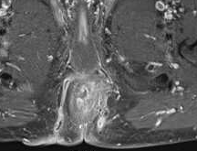
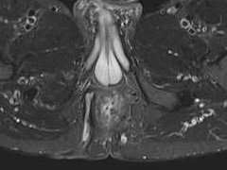
Sequences
T1 Gado FS
T1 Gado FS
    Injection
    Inflammatory tract white
    Fibrosis/Fluid black
    May overinterpret a healing fistula
STIR

Slide 10
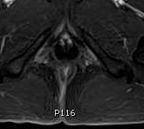
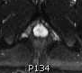
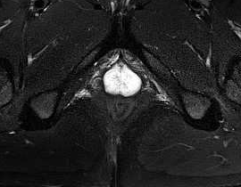
STIR vs T1 Gado FS
Gado FS
STIR versus T1 Gado FS
  Overinterpretation of enhancement with gado, while no fluid on STIR, when a fistula is on its way to heal
B 0
STIR

Slide 11
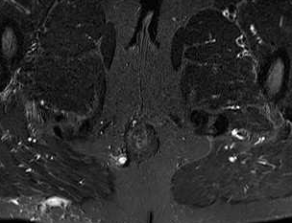
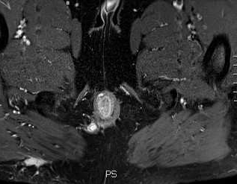
STIR vs T1 Gado FS
  Differentiate granulation tissue from fluid
  Before anti TNF treatment
STIR
Gado FS

Slide 12
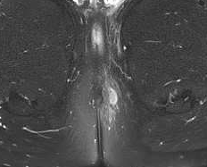
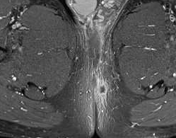
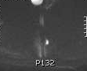
STIR vs T1 Gado FS

Slide 13
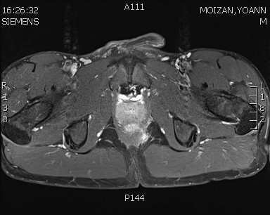
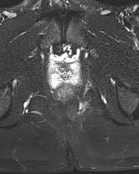
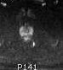
Sequences
  Combined T1 Gado FS + STIR
  Role of DW MRI?

Slide 14
Retrospective study
24 patients with surgery and Follow-up for reference
  Comparison of T2 and DWI- absence of gadolinium
  Fistula conspicuity greater with DW MRI
  Discrimination of inflammatory granuloma and abscess on the basis of ADC: 1.19 yields a sensitivity of 100 % and specificity of 90 %
Dohan et al. Eur Radiol 2014

Slide 15
MRI Technique
Slice thickness
  3-5 mm
Section Planes
  Sagittal
  Axial - relationship to sphincters
  Coronal - level of internal opening and relationship to levator ani muscles.

Slide 16
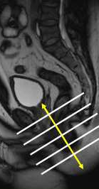
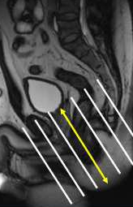
MRI Technique- Slice positioning
Important to assess the level of internal opening with regard to
puborectal muscle and better evaluation of relationship/ levator ani
Notes:
Foreshortening of the anal canal if axial strict

Slide 17
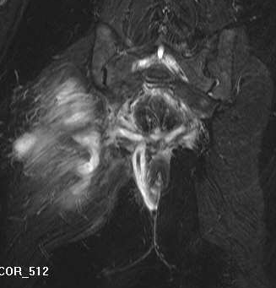
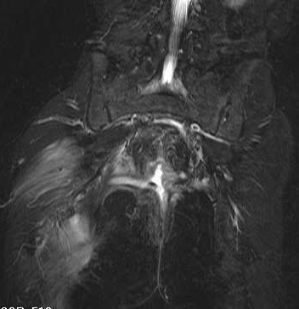
MRI Technique
FOV – not just anal canal
  In some cases must cover perineum, presacral space, supralevatorian space

Slide 18
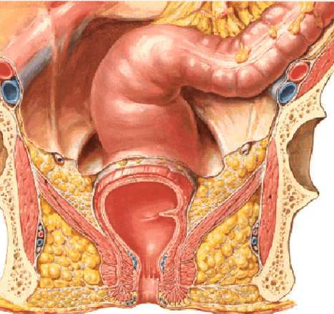
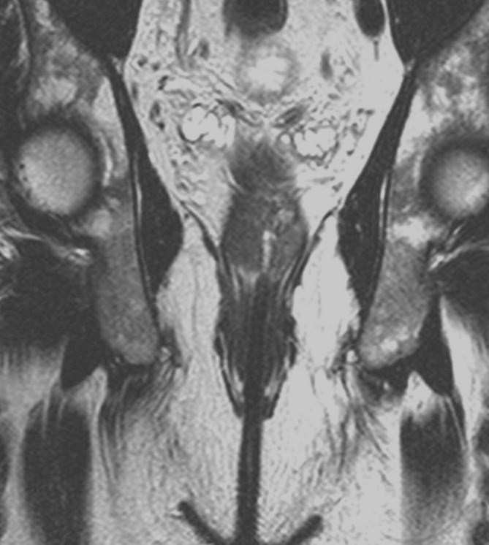
Anatomy
4 parts
  Rectum
  Anorectal junction
  Anal canal
  Anal margin
Notes:
18

Slide 19
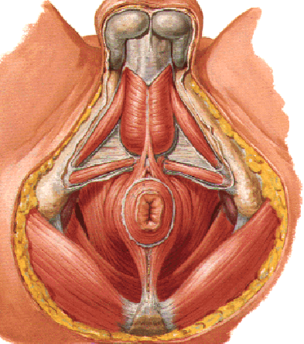
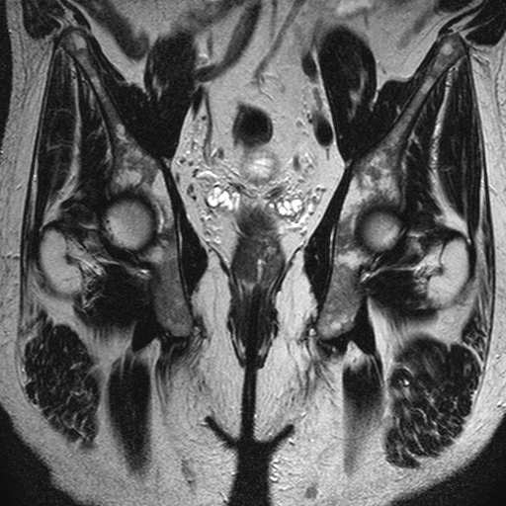
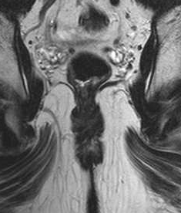
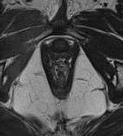
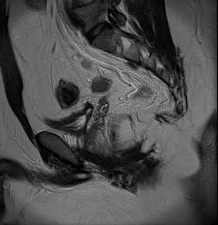
Muscles
  Levator ani
    Puborectal
Notes:
19

Slide 20
Notes:
20

Slide 21
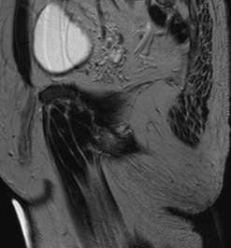
Muscles
  Levator ani
    Puborectal
    Iliococcygeal
Notes:
21

Slide 22
Levator ani muscle and obturator internus muscle
  Delineate 2 spaces
    Supralevator
    Ischioanal fossa
Notes:
22

Slide 23
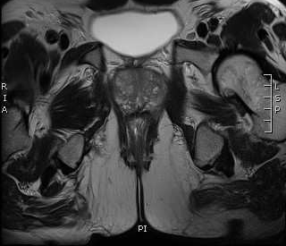
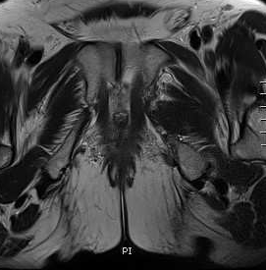
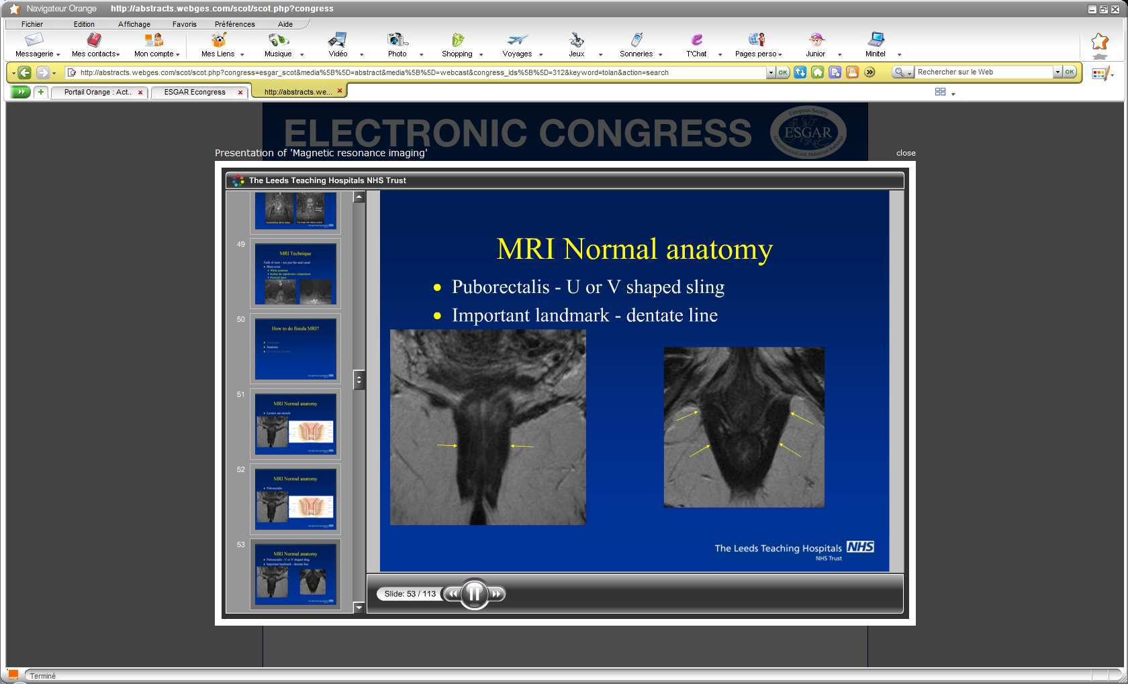
Anatomy
External Sphincter-T2
    Prolongs puborectal muscle
    Striated muscle
    Circular
    Hyposignal
2 cm
Notes:
23

Slide 24
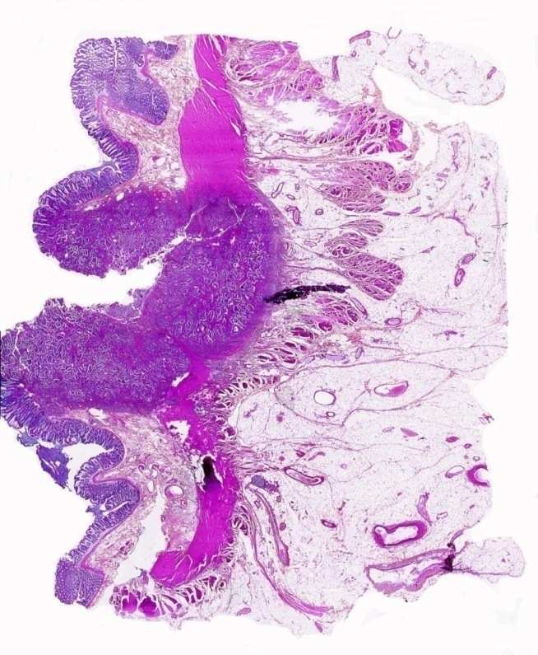
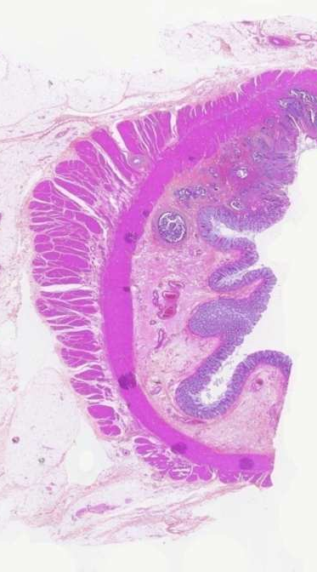
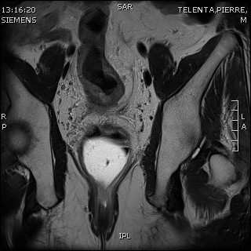
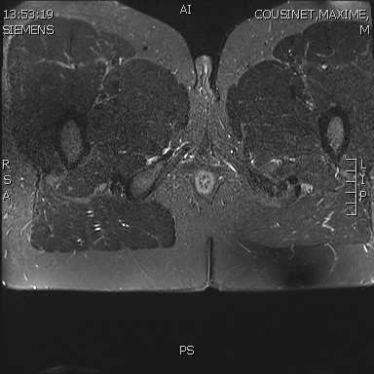
    Internal Sphincter –T2/STIR
      Prolongs rectal muscular layer
      Smooth muscle
      Circular
      Intermediate to high signal
      Enhances +++
Notes:
24

Slide 25
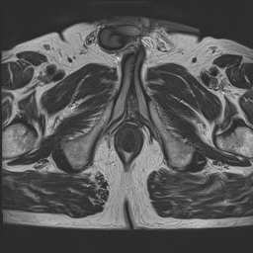
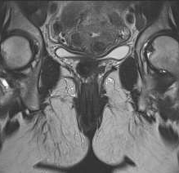
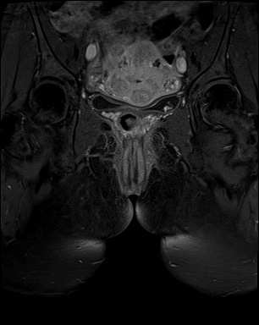
Notes:
25

Slide 26
  Both sphincters delineate an intersphincteric plane
Notes:
26

Slide 27
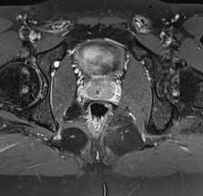
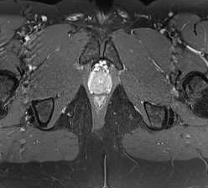
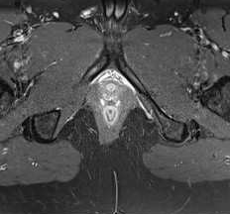
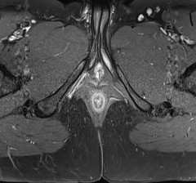
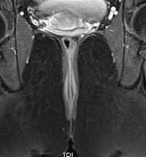
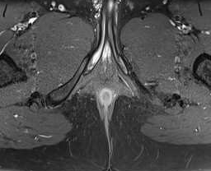
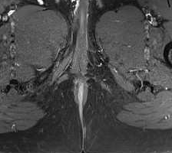

Slide 28
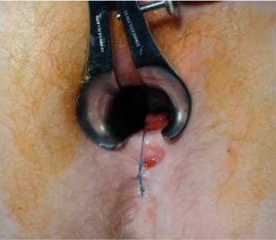
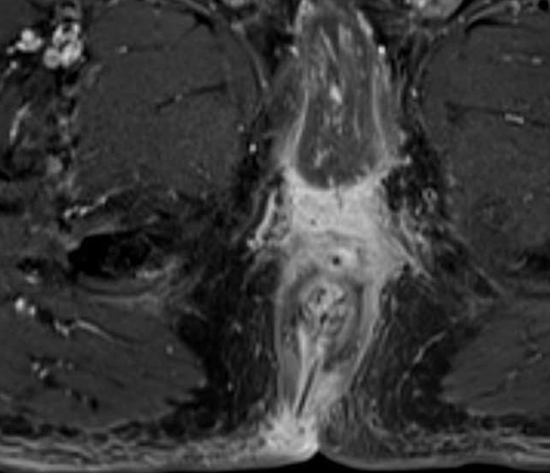
Classification
Why is it important?
  Aims of surgery
    Continence preservation
    Infectious foci and secondary tracts elimination
  Surgical Options
    Seton tight or not
    Fistulotomy-Fistulectomy
    Intersphincteric amputation, Flap

Slide 29
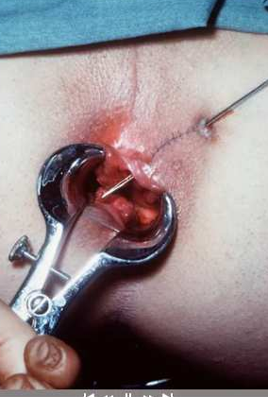
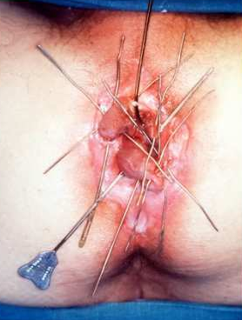

    Fistulotomy-Fistulectomy
Courtesy Dr Tolan

Slide 30




Intersphincteric amputation

Slide 31




Slide 32


Superficial Fistula
Horsthuis AJR 2004
T2

Slide 33


Intersphincteric Fistula
Involvement of internal sphincter
No risk for continence
Horsthuis AJR 2004

Slide 34






Slide 35


Transphincteric Fistula
Involvement of both internal and external sphincters
External sphicter section threatens continence
Ax gado FS

Slide 36


Transphincteric Fistula
Sometimes internal opening less obvious but predictable, located at the penetrating point of the external sphincter or at the epicenter of the intersphincteric sepsis.

Slide 37

Suprasphincteric Fistula 20 %
Rare, upwards and crosses the levator ani muscle.
Its section may threaten continence. Often inaccurately classified

Slide 38





Slide 39


Extrasphincteric Fistula
primitive rectal disease (CD, cancer, diverticulitis)
Sepsis bursting through levator ani muscle => surprise for surgeon

Slide 40


Ax Gado FS

Slide 41


Complications
Abscess

Slide 42

Complications
Dr Damian Tolan, Leeds

Slide 43

Report
1.Fistula type - simple, complex, anovaginal, horseshoe

Slide 44


Ax T2
fusion
Coro gado FS
Ax gado FS

Slide 45

Report
1.Fistula Type
2. Internal opening
  Level and position (clockwise)

Slide 46
Report
1. Fistula type
2. Internal opening
  Level and position (clockwise)
  3. Primary fistula pathway to the external opening
  Location and hour

Slide 47
Report
1.Fistula type
2. Internal opening
  Level and position (clockwise)
  3. Primary fistula pathway to the external opening
  Location and hour
  4. Number and position of supralevatorian extensions?

Slide 48
Report
1.Fistula type
2. Internal opening
  Level and position (clockwise)
  3. Primary fistula pathway to the external opening
  Location and hour
  4. Number and position of supralevatorian extensions?
  5. Number and positions of collections

Slide 49
Report
Activity Criteria
  Hypersignal T2
  Enhancement

Slide 50




Slide 51



Report
Sphincter
Rectum
T1 FS Gado

Slide 52
Questions from the surgeon
What classification?
Where is the fistula?
Where is the internal opening?
Are there any extensions?
Example: There is a transphincteric fistula in the left posterior quadrant at 4 o’ clock with an internal opening at six at the dentate line level. There is an associate intersphincteric supralevator extension from the apex of the track that reaches a 2 cm abscess just above the left levator ani plate

Slide 53
Atypical Fistulas
Verneuil
  Apocrine gland disease
  Generally bilateral + absence of perianal predominance of signs + anterior or posterior location.
  May coexist with CD
  Fistulas are rarer but may occur

Slide 54



Slide 55



Sinus Pilonidal
Hair follicle infection
No involvement of anal canal or sphincters
Posterior

Slide 56
Fournier gangrene
It is a necrotizing fasciitis involving genital, perianal and peri anal areas .
It is crucial to rapidly make the diagnosis because surgical treatment is urgently required. Even if the diagnosis is often made on a clinical basis, imaging may also allow early diagnosis and precise knowledge of the spread of the disease.
  Levenson RB, Singh AK, Novelline RA. (2008) Fournier gangrene: Role of imaging . Radiographics 28:519-28

Slide 57





T2
Fournier’s Gangrene: inflammatory infiltration of the left ischio-anal fossa associated with a small abscess, highlighted on diffusion weighted images and on enhanced images
Diff ADC
Diff b 1000
Notes:
Mobdi atika

Slide 58
Main anatomic criteria
  Fistula type
    Simple
    Complex
    Horseshoe
    Ano-vaginal
  Relationship with levator ani muscle
  Parks’classification
    Intersphincteric
    Transsphincteric
    Suprasphincteric
    Extrasphincteric
  Openings
Inflammation criteria
  Fistula
    Hypersignal T2
    Enhancement
  Abscess
  Rectal wall
Others
  Presence of a seton
  Distant extension
  Sphincteric ring abnormalities (rupture…)

Slide 59


Slide 60


Slide 61


Slide 62


Slide 63


Slide 64


Slide 65


Slide 66


Slide 67


Slide 68


Slide 69


Slide 70


Slide 71


Slide 72


Slide 73


Slide 74


Slide 75


Slide 76


Slide 77


Slide 78


Slide 79


Slide 80


Slide 81


Slide 82


Slide 83


Slide 84


Slide 85


Slide 86


Slide 87


Slide 88


Slide 89


Slide 90


Slide 91


Slide 92


Slide 93


Slide 94


Slide 95


Slide 96


Slide 97


Slide 98


Slide 99


Slide 100


